Slide 1
Immersive Virtual Reality and Gamification Within Procedurally Generated Environments to Increase Motivation During Gait Rehabilitation
Florian Kern^{a*} Carla Winter^{b} Dominik Gallª Ivo Ka ̈thner^{b} Paul Pauli^{b} Marc Erich Latoschik^{a†}
ª Human-Computer Interaction, University of Wu ̈rzburg, Am Hubland, 97074 Wu ̈rzburg, Germany
^{b} Department of Psychology I, Biological Psychology, Clinical Psychology and Psychotherapy, University of Wu ̈rzburg, Wu ̈rzburg, Germany

Slide 2
INTRODUCTION
Multiple sclerosis（多发性硬化症） commonly induces（诱导）motor deficits（障碍）of the lower limbs. These deficits limit the ability to walk and to perform daily activities. People with multiple sclerosis frequently show reduced stride length, gait speed and balance control.
Physical exercises reduce motor deficits in patients with multiple sclerosis. Treadmill（跑步机）exercise is an efficient therapy（治疗方案）to reduce motor deficits of the lower limbs. Treadmill training shows significant improvements in walking ability and gait variability.
Virtual Reality (VR) provides a promising tool to increase motivation in gait rehabilitation. VR simulates a real environment and allows interaction（交互）with objects and virtual events.
VR based treadmill training improved gait speed, endurance（耐久力）and the number of the patients’ repetitions. Furthermore, patients experienced higher task focus and expressed a more positive attitude towards training and some users reported reduced pain.
Therefore, we propose to extend previous approaches with a particular focus on fostering（培养）autonomy, relatedness, and competence in immersive VR rehabilitation systems.

Slide 3
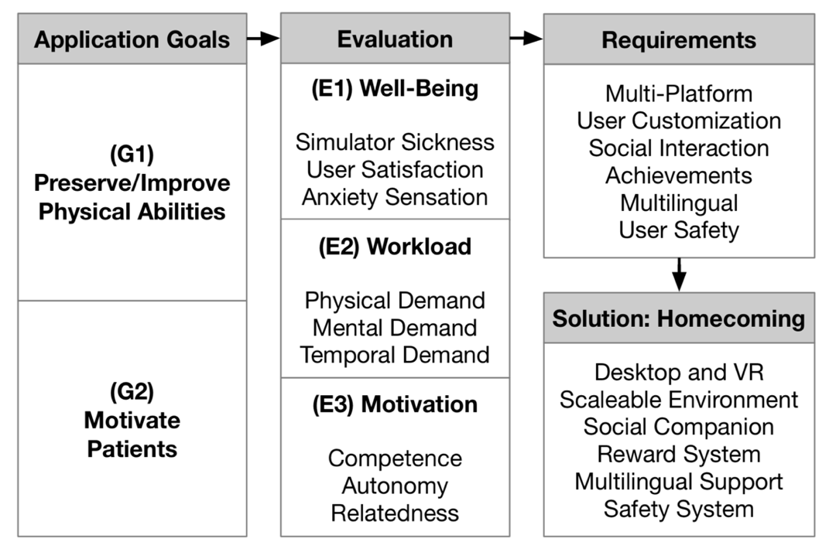
PROBLEM TO SOLVE
Simulator Sickness 眩晕感
Anxiety sensation 焦虑感
Temporal demand 时间需求
Multilingual 多语言的
Scalable Environment 可扩展的环境

Slide 4
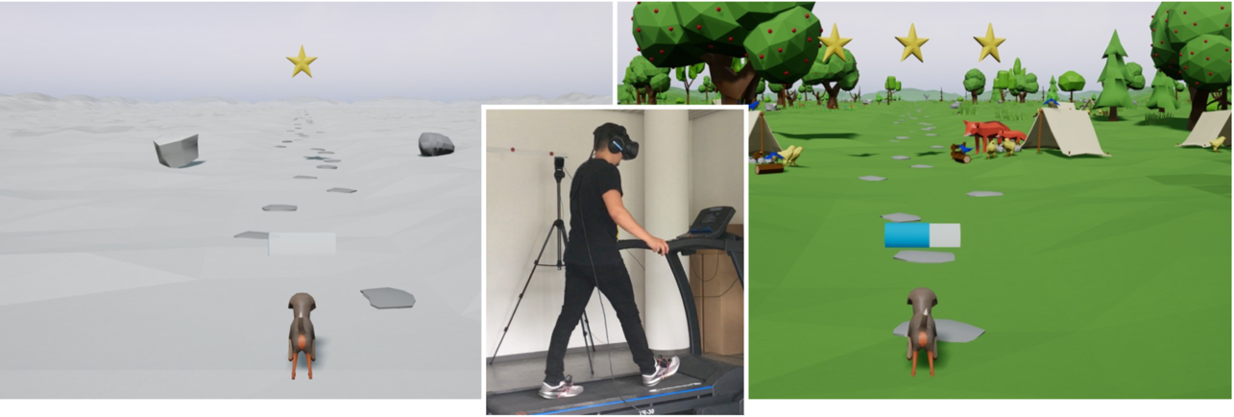
SOLUTION / CONCEPTUAL DESIGN
Our solution combines an engaging（吸引人的）storyline with a gamified reward system and social interactions to motivate patients during their treadmill training.
Our VR rehabilitation approach motivates patients to walk for longer periods while reducing perceived（感知）physical demands and effort.
The entire training session is based on a storyline, which tells the story of Max and his friends. Max is a small dog and tells the patient that he and his friends lost their homes in a storm and asks the patient for support. Max explains that the patient only has to walk inside the virtual world to restore his home.

Slide 5
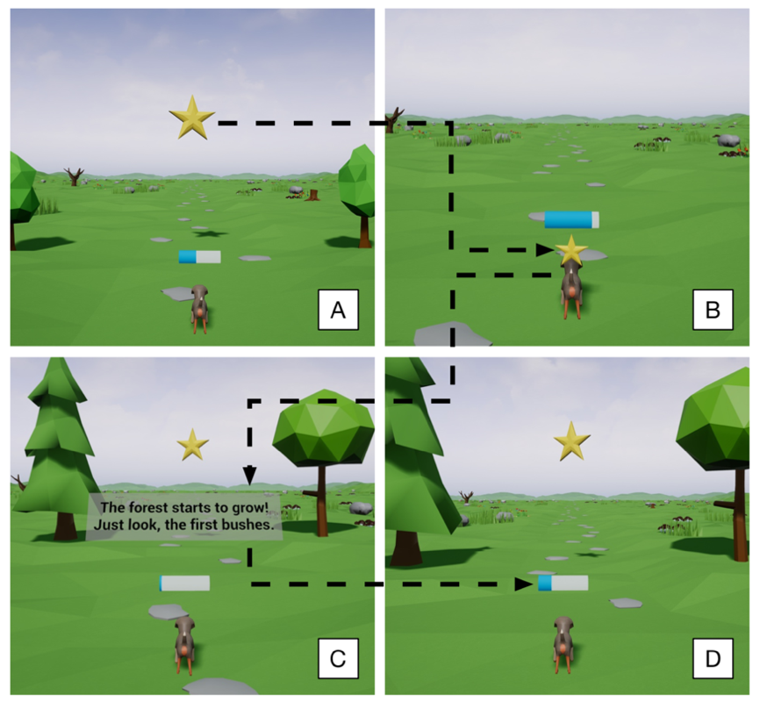
During the walking task, the patient follows Max on a straight path with stones on the ground. While the patient walks on the treadmill, the virtual world grows and becomes more beautiful. For this, the virtual world changes from an empty and lifeless desert to an inhabited green forest including flowers, bushes, trees, and animals. Max rewards the patient for reaching certain walking distances and shows his happiness and excitement through positive visual and auditive feedback. During the whole training session, the patient listens to a happy and motivating piano background audio.
The process of receiving a reward consists of four steps.
(A) The patient walks toward a reward.
(B) When he reaches a certain distance, the social companion receives the star.
(C) The social companion rewards the patient immediately after the star disappears.
(D) The reward system already spawns the next reward on the way and the patient reduces the distance to this reward

Slide 6
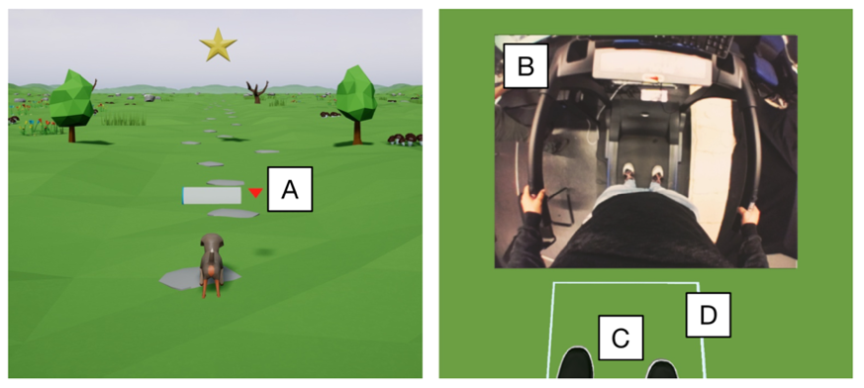
Safety System
the left part shows the front view
the right part shows the bottom view
The safety system uses arrows（箭头）to indicate whether the patient is too far forward or too far back on the treadmill
(A). If the participant looks downward, the safety system displays a video stream of the world around the participant
(B). If participants look downward, they see a virtual representation of their feet and the outlines of the treadmill surface.

Slide 7
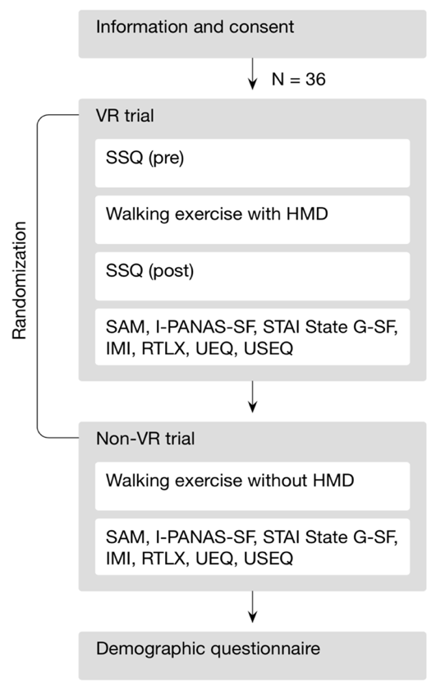
EXPERIMENTAL METHOD
Non-VR vs. VR
Participants: Undergraduate students (N = 37; 16 women) participated in the experiment in exchange for course credit. The age of the participants ranged from 19 to 30 years (M = 22.68, SD = 2.64). All reported normal or corrected-to-normal vision（视力正常/矫正正常）and the absence of motor impairments（无运动障碍）.
Apparatus :
Treadmill: Cardiostrong TR30
0.8 km/h to 18 km/h
running surface of 135 cm x 49 cm
Unreal Engine 4.18
Windows 10, i7-6700K, 16 GB DDR4-RAM, Nvidia GeForce GTX 1080
HTC Vive, HTC Vive Tracker
circumaural headphones

Slide 8
EXPERIMENTAL METHOD
Non-VR vs. VR
Measures（8个）
The Simulator Sickness Questionnaire (SSQ) （眩晕感）
The Self-Assessment Manikin (SAM) 自我评估模型（情感）
The International Positive and Negative Affect Schedule - Short Form (I-PANAS-SF) （评估整体情绪）
the State-Trait-Anxiety Inventory German Version (STAI State G-SF) （焦虑感）
the Intrinsic Motivation Inventory (IMI) （内在动机）
a simplified form of the NASA Task Load Index (NASA-TLX) called Raw TLX (RTLX) （任务量负荷）
the User Experience Questionnaire (UEQ) （用户体验）
the User Satisfaction Evaluation Questionnaire (USEQ) （用户满意度）
Procedure
VR: HTC Vive head-mounted display and circumaural headphones
Non-VR: not exposed to the VR application
participants walked on a treadmill for 7.5 min at 4 km/h

Slide 9
EXPERIMENTAL METHOD
Statistical Analysis
two-tailed paired t-tests（双总体配对样本t检验）to compare ratings between the VR and Non-VR condition.
set a priori significant level（先验性显著水平） to p < .05 for all statistical tests.
Cohen’s d as a measure of effect size.

Slide 10
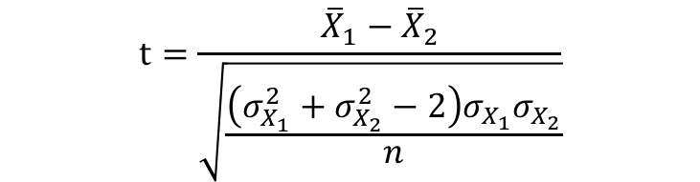
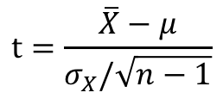
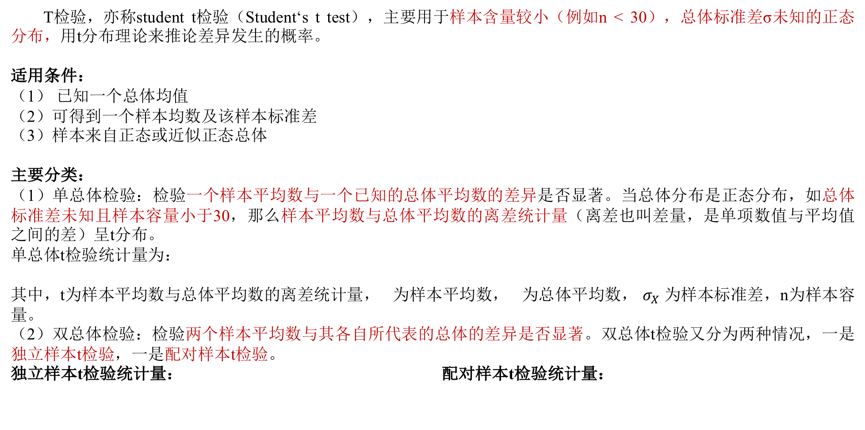
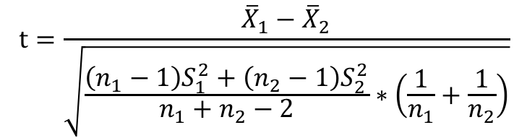


T检验，亦称student t检验（Student‘s t test），主要用于样本含量较小（例如n < 30），总体标准差σ未知的正态分布，用t分布理论来推论差异发生的概率。
适用条件：
（1） 已知一个总体均值
（2）可得到一个样本均数及该样本标准差
（3）样本来自正态或近似正态总体
主要分类：
（1）单总体检验：检验一个样本平均数与一个已知的总体平均数的差异是否显著。当总体分布是正态分布，如总体标准差未知且样本容量小于30，那么样本平均数与总体平均数的离差统计量（离差也叫差量，是单项数值与平均值之间的差）呈t分布。
单总体t检验统计量为：
其中，t为样本平均数与总体平均数的离差统计量， 为样本平均数， 为总体平均数， $σ_{X}$ 为样本标准差，n为样本容量。
（2）双总体检验：检验两个样本平均数与其各自所代表的总体的差异是否显著。双总体t检验又分为两种情况，一是独立样本t检验，一是配对样本t检验。
独立样本t检验统计量： 配对样本t检验统计量：
$$t=\frac{\overline{X}−μ}{σ_{X}/\sqrt{n−1}}$$
$$\overline{X}$$
$$μ$$
$$t=\frac{{\overline{X}}_{1}−{\overline{X}}_{2}}{\sqrt{\frac{\left(n_{1}−1\right)S_{1}^{2}+\left(n_{2}−1\right)S_{2}^{2}}{n_{1}+n_{2}−2}∗\left(\frac{1}{n_{1}}+\frac{1}{n_{2}}\right)}}$$
$$t=\frac{{\overline{X}}_{1}−{\overline{X}}_{2}}{\sqrt{\frac{\left(σ_{X_{1}}^{2}+σ_{X_{2}}^{2}−2\right)σ_{X_{1}}σ_{X_{2}}}{n}}}$$
其中，$S_{1}^{2}$和$S_{2}^{2}$为两样本方差，$n_{1}$和$n_{2}$为两样本容量
其中，${\overline{X}}_{1}$和${\overline{X}}_{2}$为两样本平均数，$σ_{X_{1}}^{2}$和$σ_{X_{2}}^{2}$为两样本方差

Slide 11
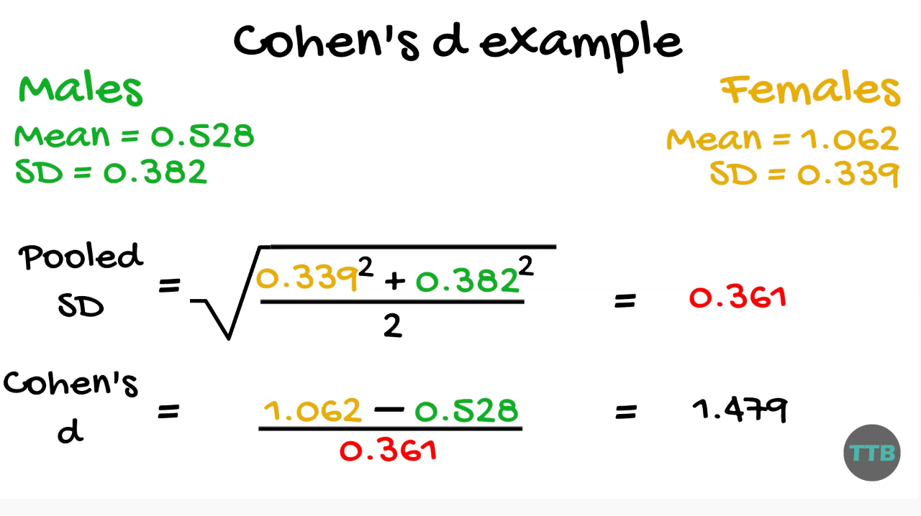
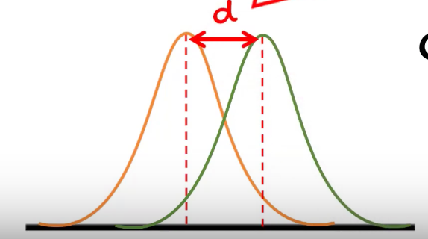
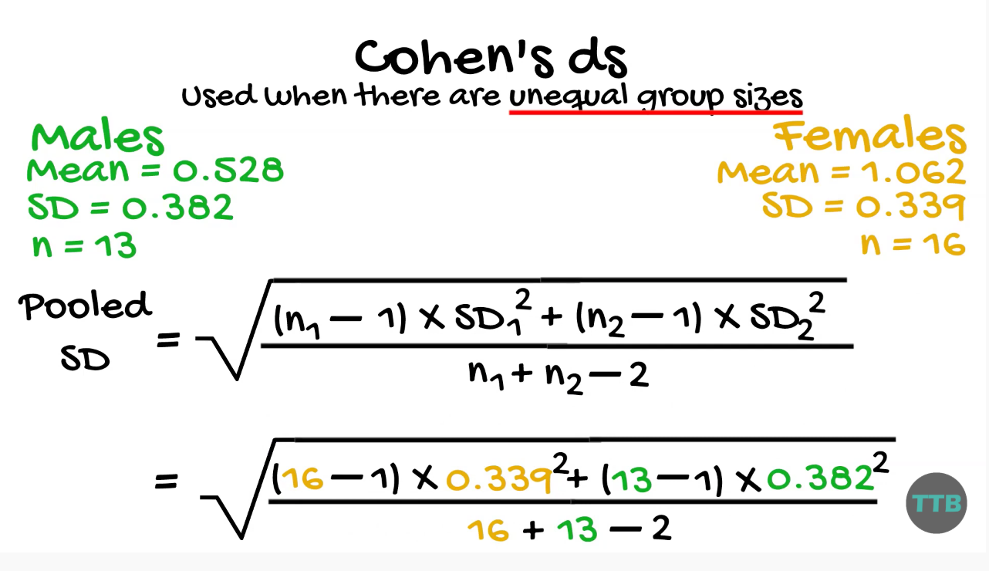
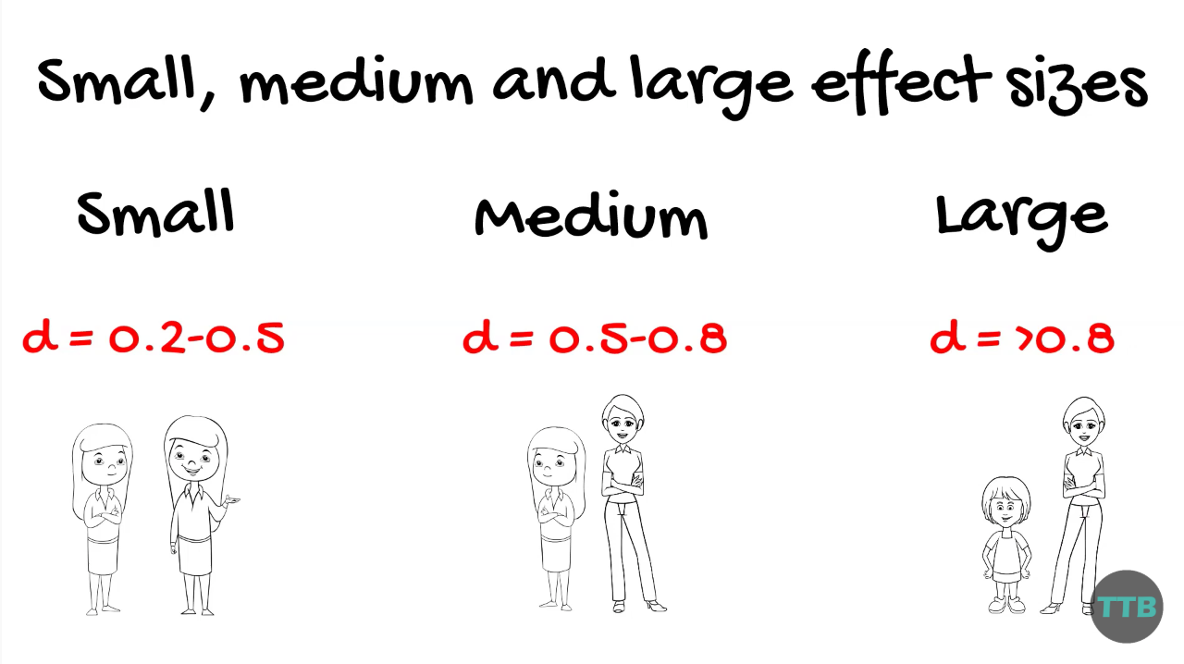
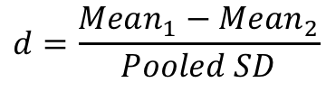
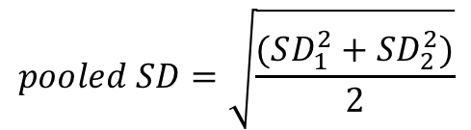
Cohen’s d
Cohen’s d is a type of effect size between two means
Use when there are equal group sizes
$$pooled SD=\sqrt{\frac{(SD_{1}^{2}+SD_{2}^{2})}{2}}$$
$$d=\frac{Mean_{1}−Mean_{2}}{Pooled SD}$$
Use when there are unequal group sizes

Slide 12
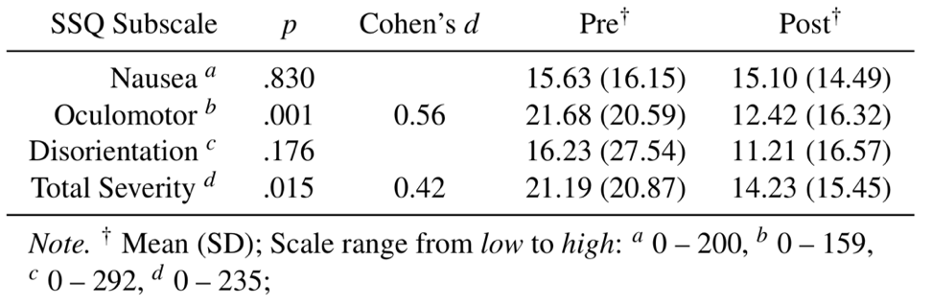
RESULTS
SSQ
眩晕感
We compared simulator sickness ratings in the VR condition before and after VR exposure (See table 1). The SSQ subscales Oculomotor(动眼) (t(35) = 3.38, p = .001, d = 0.56), and Total Severity(剧烈程度) (t(35) = 2.53, p = .015, d = 0.42) revealed significantly lower ratings after VR exposure compared to before VR expose. We found no significant differences for the SSQ subscales Nausea(呕吐感)(t(35) = 0.21, p = .830) and Disorientation(丢失方向感) (t(35) = 1.37, p = .176).
shows the mean comparisons of the SSQ scores prior and post the VR condition

Slide 13
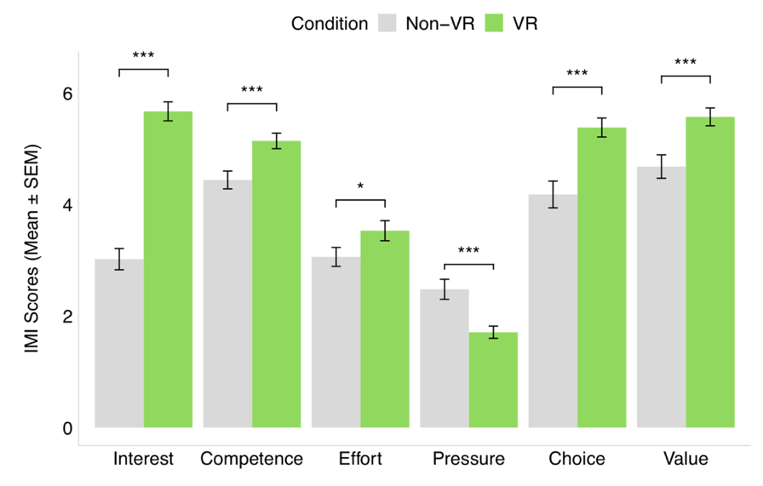
RESULTS
IMI
内在动机
All IMI subscales revealed significant differences between the VR and the Non-VR condition. In the VR condition we identified significantly higher Interest (t(35) = 9.90, p < .001, d = 1.65), Competence (t(35) = 5.01, p < .001, d = 0.83), Effort (t(35) = 2.24, p = .030, d = 0.37), Choice (t(35) = 5.52, p < .001, d = 0.92) and Value (t(35) = 5.22, p < .001, d = 0.87) ratings compared to the Non-VR condition. In the VR condition we identified significantly lower Pressure (t(35) = −4.14, p < .001, d = 0.69) ratings compared to the Non-VR condition.
Score on the IMI subscales in the Non-VR and VR conditions. Participants showed a significantly higher result for Interest, Competence, Effort, Choice, and Value. Participants showed a significantly lower result for Pressure. Likert scales range from 1 (low) to 7 (high). * p < .05, *** p < .001.

Slide 14
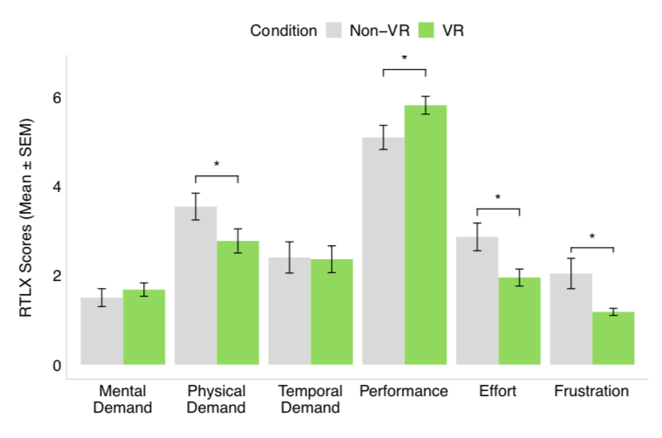
RESULTS
Raw TLX
任务量负荷
The RTLX subscale Performance (t(21) = 2.66, p = .014, d = 0.56) revealed significantly higher ratings in the VR condition compared to the Non-VR condition. The RTLX subscales Physical Demand (t(21) = −2.85, p = .009, d = 0.60), Effort (t(21) = −2.66, p = .014, d = 0.56), Frustration(失望感) (t(21) = −2.51, p = .020, d = 0.53) revealed significantly lower ratings in the VR condition compared to the Non-VR condition. We found no significant differences for the RTLX subscales Mental Demand (t(21) = 0.74, p = .462) and Temporal Demand (t(21) = −0.12, p = .904).
Score on the RTLX subscales in the Non-VR and VR conditions. Participants showed a significant increase for Performance and a significant decrease for Physical Demand, Effort, and Frustration. Likert scales range from 1 (low) to 7 (high). * p < .05.

Slide 15
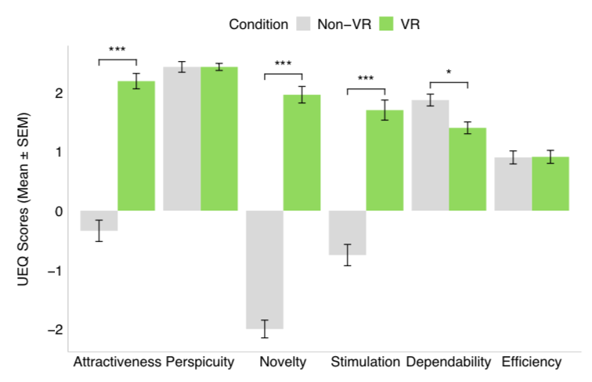
RESULTS
UEQ and USEQ
用户体验和用户满意度
The UEQ subscales Attractiveness (t(35) = 11.1, p < .001, d = 1.85), Novelty (t(35) = 19.0, p < .001, d = 3.16), and Stimulation (t(35) = 10.7, p < .001, d = 1.79) revealed significantly higher ratings in the VR condition compared to the Non-VR condition. The UEQ subscale Dependability (t(35) = −3.56, p = .001, d = 0.59) revealed significantly lower ratings in the VR condition compared to the Non-VR condition. We found no significant differences for the UEQ subscales Perspicuity (t(35) = 0, p = 1.00) and Efficiency (t(35) = 0.09, p = .922). We found a significantly higher USEQ total score in the VR condition compared to the Non-VR condition (t(35) = 7.30, p < .001, d = 1.21).
Score on the UEQ subscales in the Non-VR and VR conditions. Participants showed a significantly higher result for Attractive- ness, Novelty, and Stimulation. Participants showed a significantly lower result for Dependability. Likert scales range from -3 (low) to 3 (high). * p < .05, *** p < .001.

Slide 16
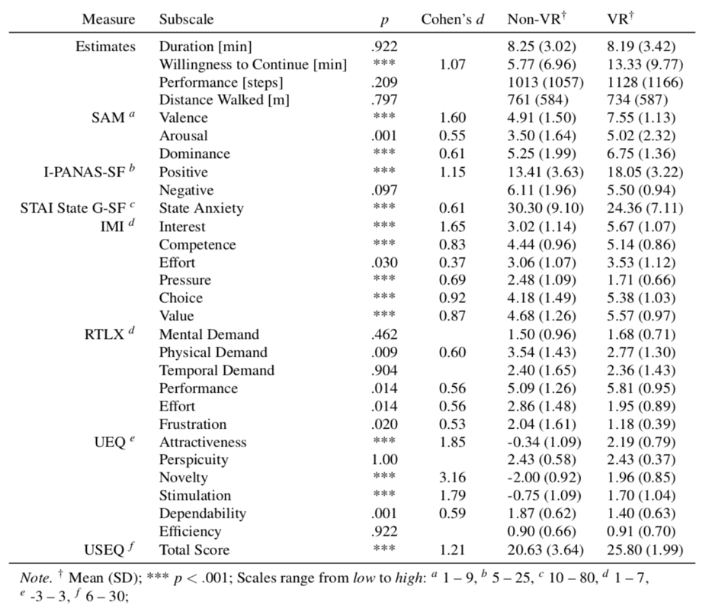
In the VR condition, participants were willing to continue for a significantly longer period of time than in the Non-VR condition (t(35) = 6.42, p < .001, d = 1.07). They did not estimate the duration of the exercise（运动时间） (t(35) = −0.09, p = .922), the performed steps（执行步骤） (t(35) = 1.27, p = .209), or the distance walked (t(21) = −0.25, p = .797) differently between both conditions.
RESULTS
All SAM（自我评估模型（情感））subscales revealed significant differences between the VR and the Non-VR condition. In the VR condition we identified significantly higher Valence（效果）(t(35) = 9.64, p < .001, d = 1.6), Arousal（激励）(t(35) = 3.34, p = .001, d = 0.55), and Dominance（支配）(t(35) = 3.68, p < .001, d = 0.61) compared to the Non-VR condition. The I-PANAS-SF （评估整体情绪）Positive Affect scale revealed significantly higher scores in the VR condition compared to the Non-VR condition (t(35) = 6.90, p < .001, d = 1.15). The I-PANAS-SF Negative Affect scale revealed no significant difference between both conditions (t(35) = −1.70, p = .097). STAI State G-SF（焦虑感）scores reveals significantly lower state anxiety ratings in the VR condition compared to the Non-VR condition (t(35) = −3.71, p < .001, d = 0.61).
summarizes the comparisons between the VR and the Non-VR condition for all conducted scales

Slide 17
CONCLUSION
(1) We presented an immersive VR rehabilitation system for gait rehabilitation. Our approach extends previous studies that foster competence to increase motivation.
(2) We propose to foster the experience of autonomy and relatedness in VR rehabilitation systems. To foster prolonged(长期的) motivation, competence, autonomy, and relatedness were operationalized within this study.
(3) These elements include an engaging storyline, a gamified reward system, and a social companion.
(4) In the VR condition, participants reported increased decision freedom, increased perceived(察觉) task meaningfulness, lower anxiety, lower frustration（挫折）, and lower pressure.
Design Implications for Future Applications in Gait Rehabilitation
(1) Immersive VR Provides a Promising Augmentation for Gait Rehabilitation
(2) Gamification Features Provide a Design Guideline for Content Creation in Gait Rehabilitation
(3) Relatedness and Autonomy Provide Critical Content Features in Gait Rehabilitation
Limitations
(1) The study had a repeated measures design. Hence, the experience of the first condition might influence the experience of the second condition. The balanced-randomization distributes this effect equally, however, a systematic bias（系统误差） may remain.
(2) A novelty(新颖的) effect for immersive VR treadmill training might confound the results.
(3) We conducted the study only with healthy participants.

